Slide 1
Tidyverse
Introduction to Computational CMB
Alex Alon
February 19th, 2025

Slide 2
Things to add to this powerpoint
How to look up functions from tidyverse
How to pull up documentation about a function

Slide 3
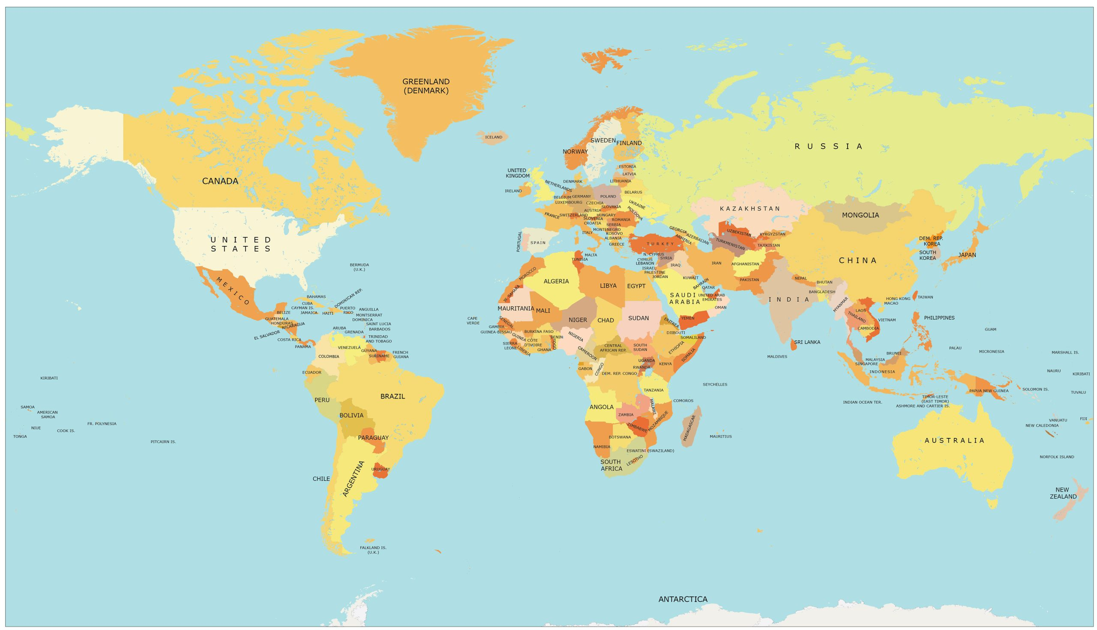


Slide 4

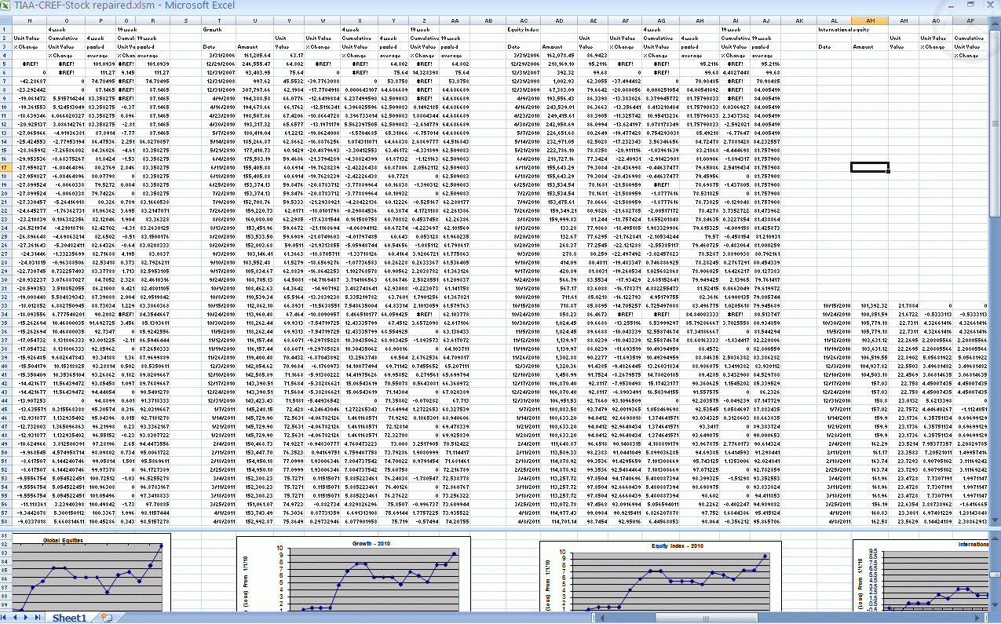
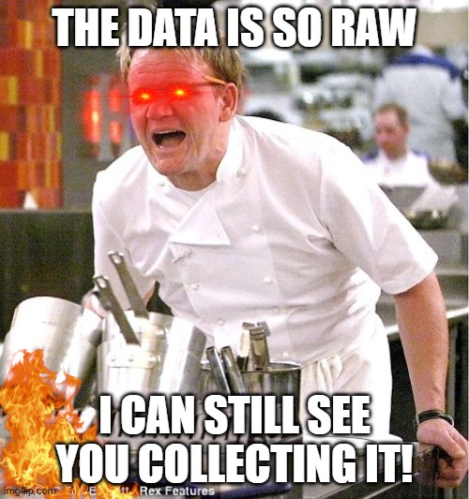

Slide 5
Wednesday Objectives
Learn about tidy data
Learn about dplyr and tidyr
Learn about ’pipe’ operator %>%
Manipulate data using dplyr -- select, slice, filter, mutate, summarize, group_by, count
Learn about wide vs long table format
Manipulate data using tidyr -- reshape a data frame from long to wide and back using pivot_wider and pivot_longer

Slide 6
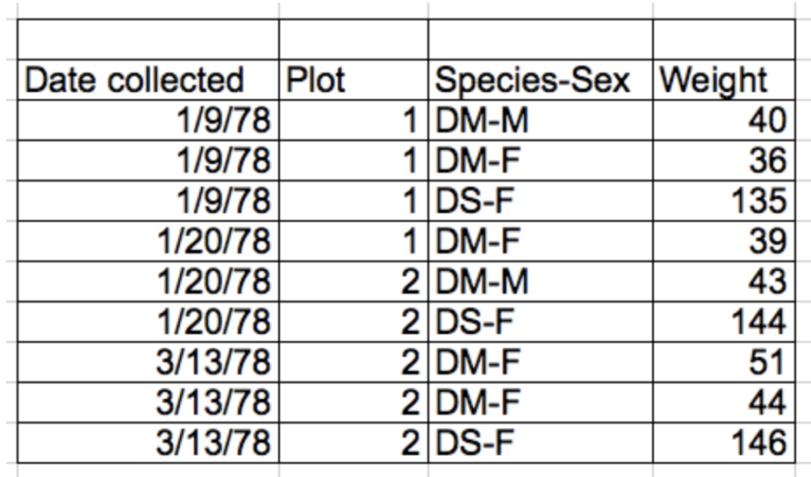
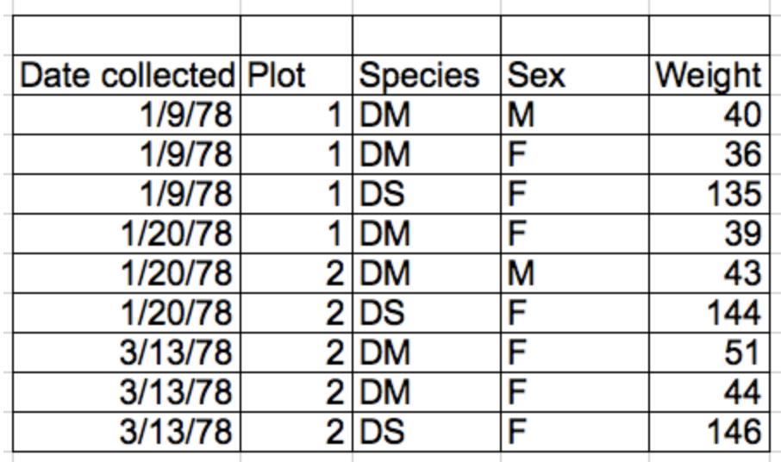
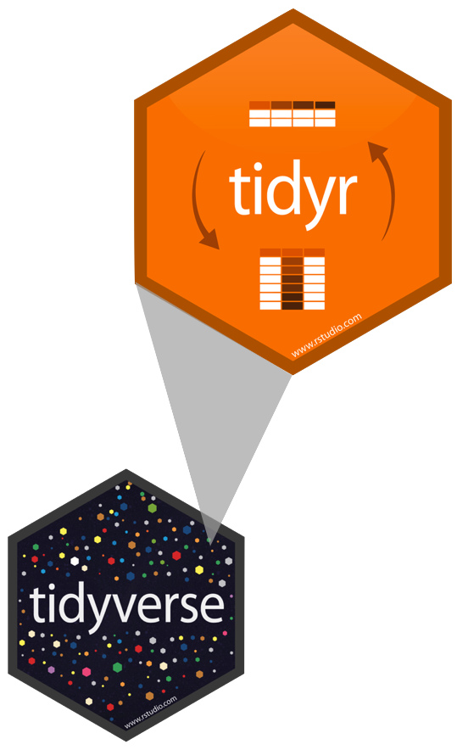
Tidy Data
Rules defining tidy data:
Each unique variable has its own column – thing you are measuring
Each observation has its own row
Each value must have its own cell – don’t combine data in a single cell!
Leave the raw data raw
Each type of observational unit forms a table
columns = variables, rows = observations, cells = data

Slide 7
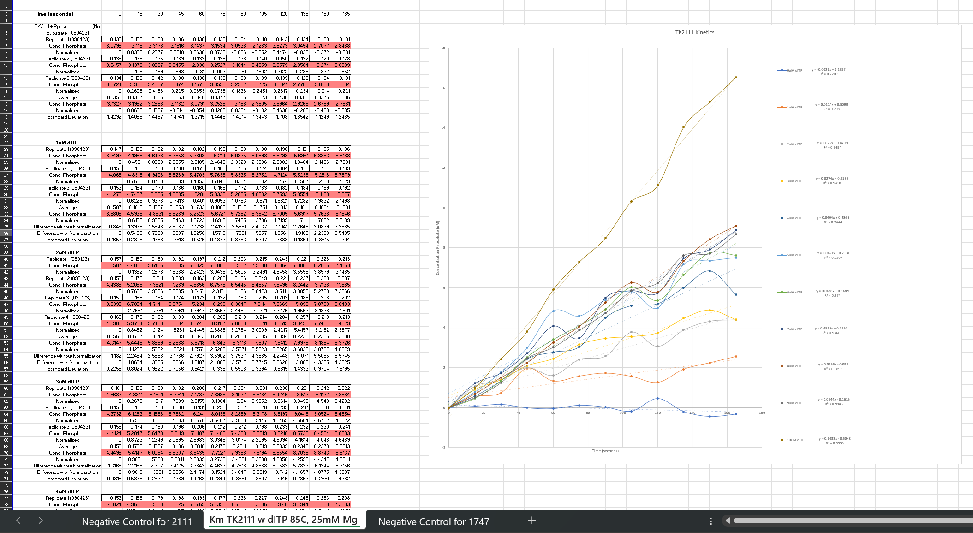
Columns include values
Color coding
Rows have variables with repeating names
Statistics and data
Manipulation performed on data sheet
Graph made on spreadsheet
Multiple Tabs of Analysis

Slide 8
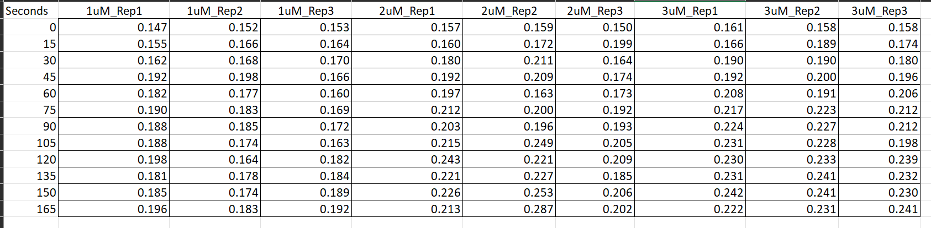
Is this tidy data?
New column can be made of replicates
New column can be made of concentrations

Slide 9
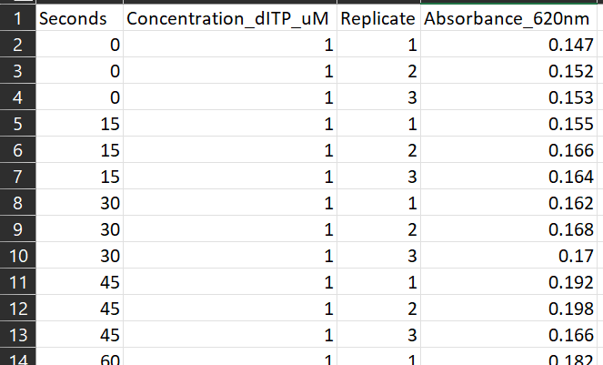

Time made into column with values
Unique column variable names

Slide 10
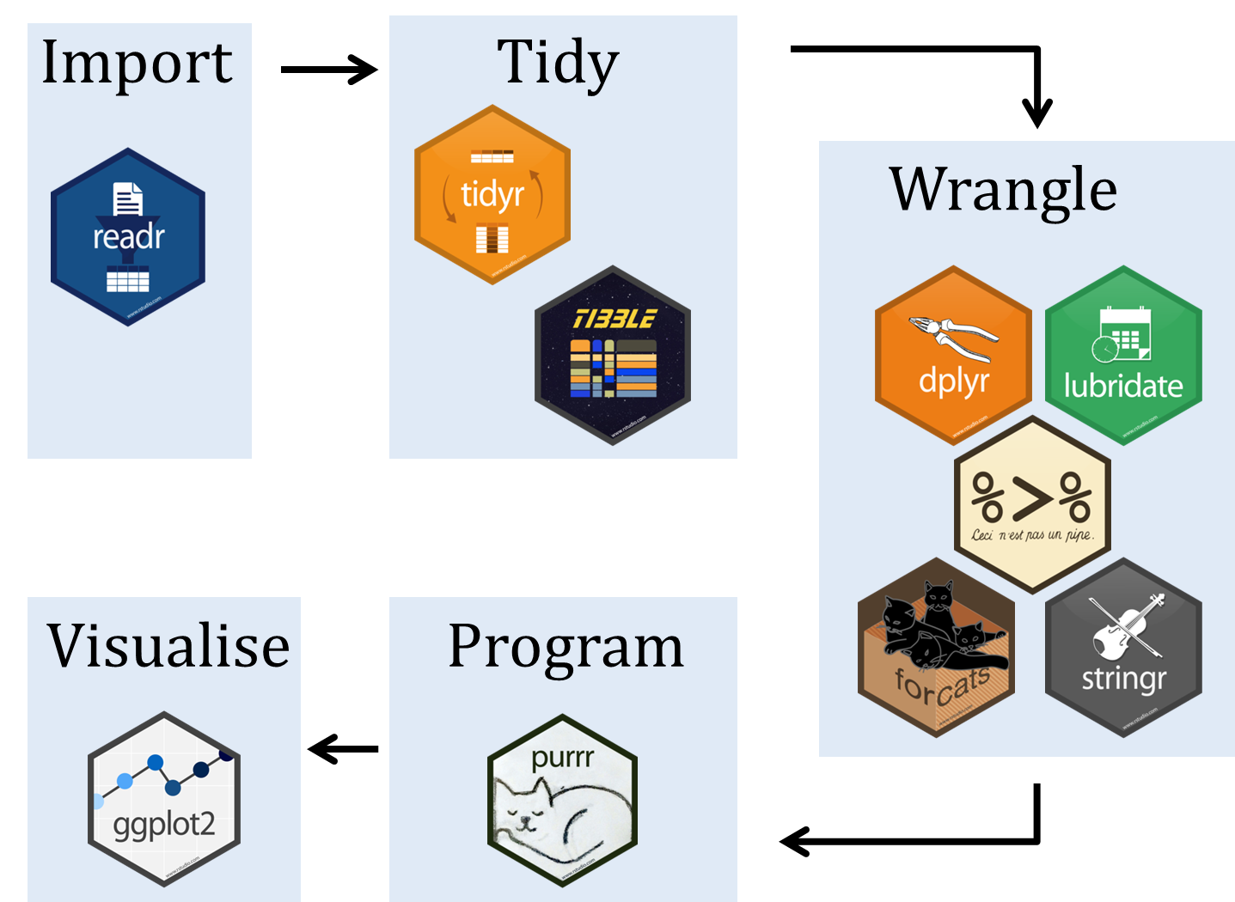

What is tidyverse?

Slide 11
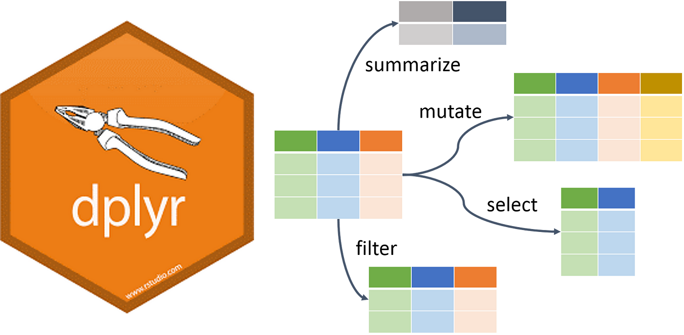
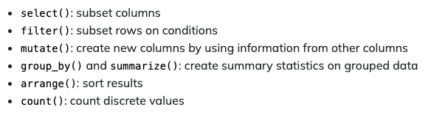
What is dplyr?

Slide 12
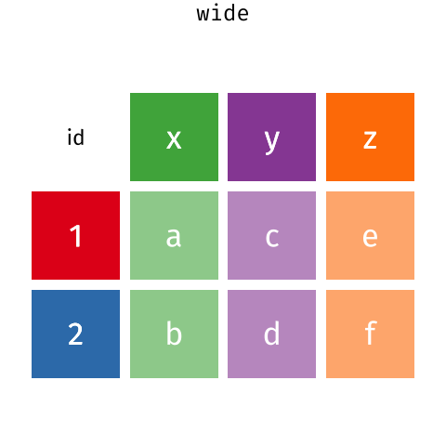
What is tidyr?

Slide 13
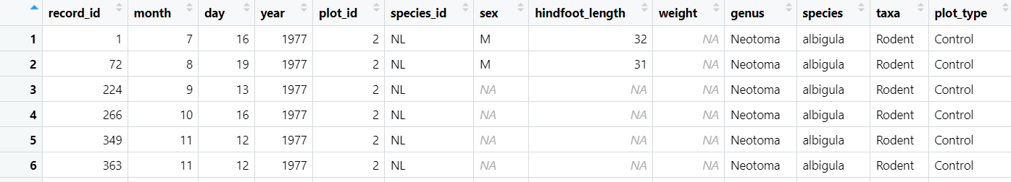
Dplyr: Selecting columns
Selecting columns of a data frame
Format: select(df, col1, col2)
Selecting all columns except certain ones
Format: select(df, -col1, -col2)

Slide 14
Dplyr: Filtering rows
Filtering rows
Format: filter(df, col1 >300 & col1 <100)

Slide 15
filter(!is.na(surveys$sex))

Slide 16
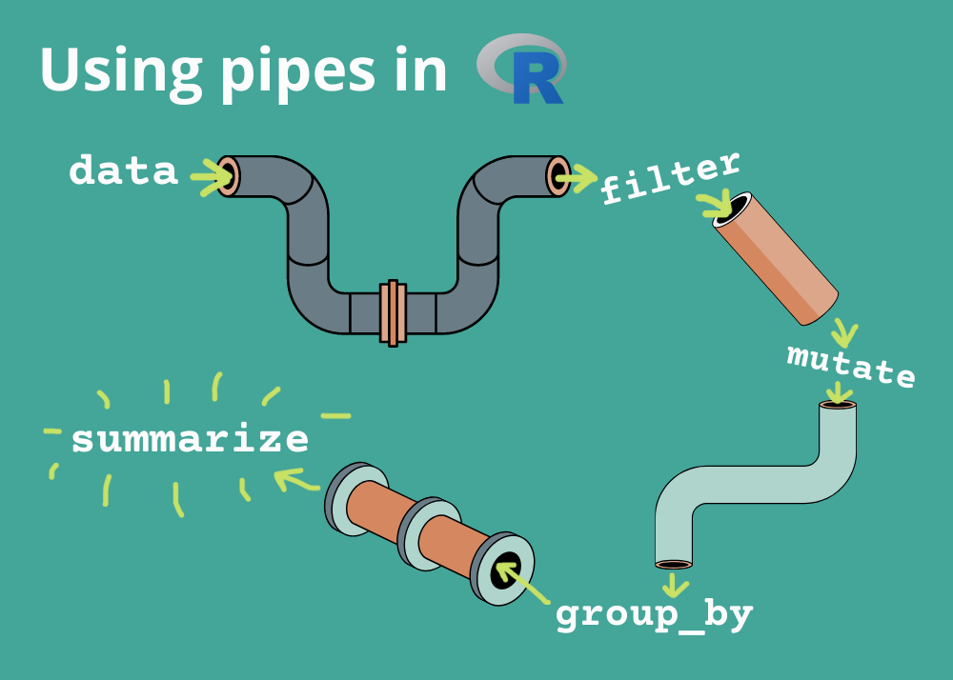
What are pipes? %>%
With dplyr we can perform a series of operations using pipes
Pipes will send the results of one function into another using the pipe operator (%>%)
One line of code is now equivalent to multiple

Slide 17
Dplyr: Pipes
Without Pipes
surveys_2<- filter(surveys$sex == M)
surveys_3<-select(surveys_2$species_ed, sex, weight)
With Pipes
surveys %>%
filter(sex == M) %>%
select(species_id, sex, weight)

Slide 18
Dplyr: Pipes
Piping shortcut!
Piping into new object
surveys_sml <- surveys %>%
filter(sex == M) %>%
select(species_id, sex, weight)
surveys %>%
filter(sex == M) %>%
select(species_id, sex, weight)
*Does not change surveys variable*
surveys <- surveys %>%
filter(sex == M) %>%
select(species_id, sex, weight)
*Does change surveys variable*

Slide 19
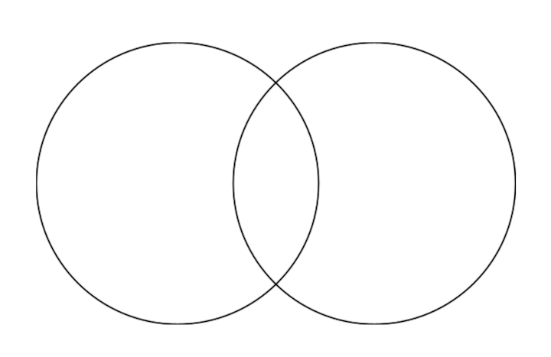
Dplyr: Filtering for multiple conditions
filter(!is.na(surveys$sex)) – filter out NA values
AND
filter( sex == M & year <=1978)
Has to meet both conditions
filter( sex == M | year <=1978)
Has to meet either condition
1977
1978
1979
1980
1981
…
M
F
NA
Sex = M
Year = 1978
OR

Slide 20
Dplyr: Mutate
Creating new columns based on existing columns (for example, unit conversion or find the ratio between two columns)
To create a new column of weight in kg:
surveys %>%
mutate(weight_kg = weight / 1000)
To create a second column based off first new column:
surveys %>%
mutate(weight_kg = weight / 1000,
weight_lb = weight_kg * 2.2)

Slide 21
Dplyr: Group_by and summarize
Split-apply-combine paradigm: split the data into groups, apply some analysis to each group, and then combine the results
Group_by() is often used together with summarize(), which collapses each group into a single row summary of that group.
Step 1: Grouping by sex
Step 2: Summarizing mean weight (removing NAs)
Stepwise:
surveys2 <- group_by(surveys, sex)
surveys_sml <- summarize(mean_weight = mean(weight, na.rm = TRUE))

Slide 22
Dplyr: Group_by and summarize Descending order
To sort a column in descending order, we need to add desc() function. For example, sorting the results by decreasing order of mean weight
surveys %>%
filter(!is.na(weight)) %>%
group_by(sex, species_id) %>%
summarize(mean_weight = mean(weight),
min_weight = min(weight)) %>%
arrange(desc(mean_weight))

Slide 23
Dplyr: Counting
If we want to know the number of observations found for each factor or combinations of factors, we can use count().
surveys %>%
count(sex)
To count a combination of factors
surveys %>%
count(sex, species)
To count a combination of factors AND sort output
surveys %>%
count(sex, species)%>%
arrange(species, desc(n))

Slide 24
PRACTICE TIME

Slide 25
After Chunk 30, 10 min. break

Slide 26
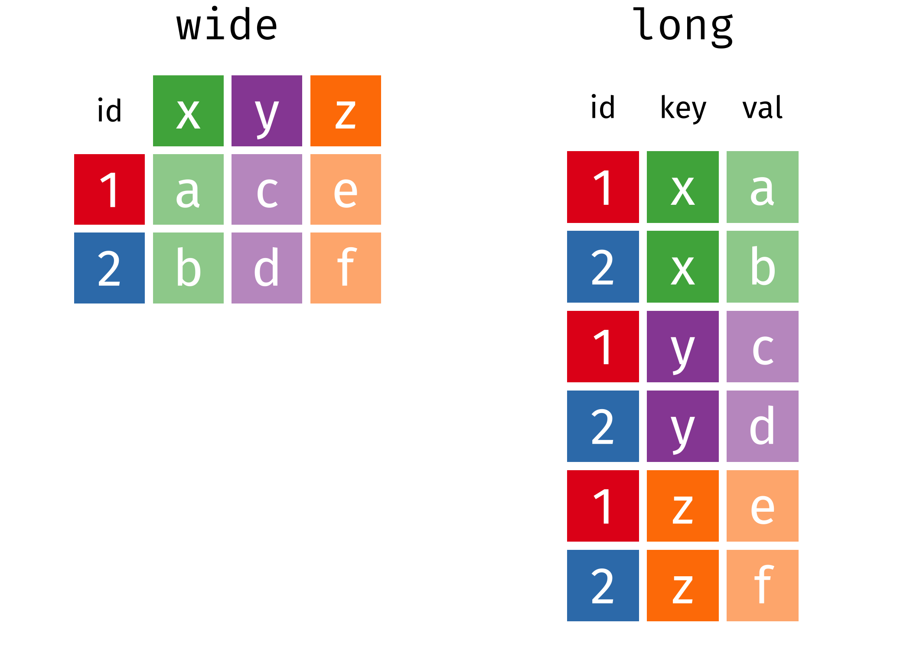
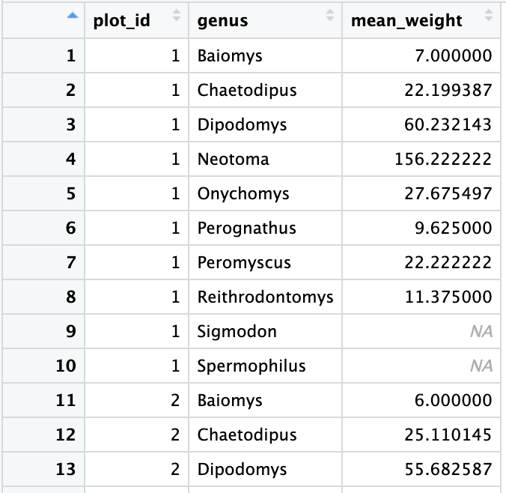
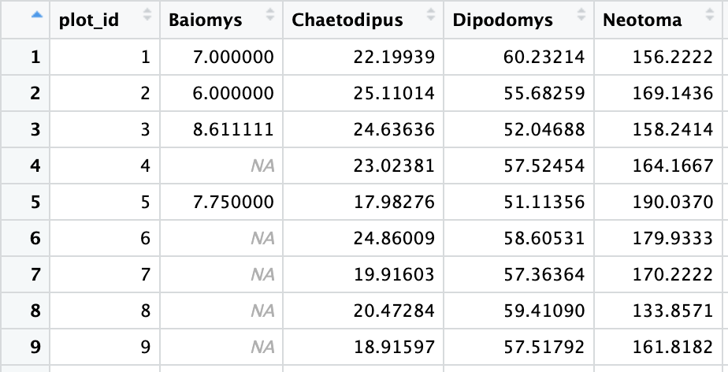
Tidyr: Wide vs. Long Format

Slide 27
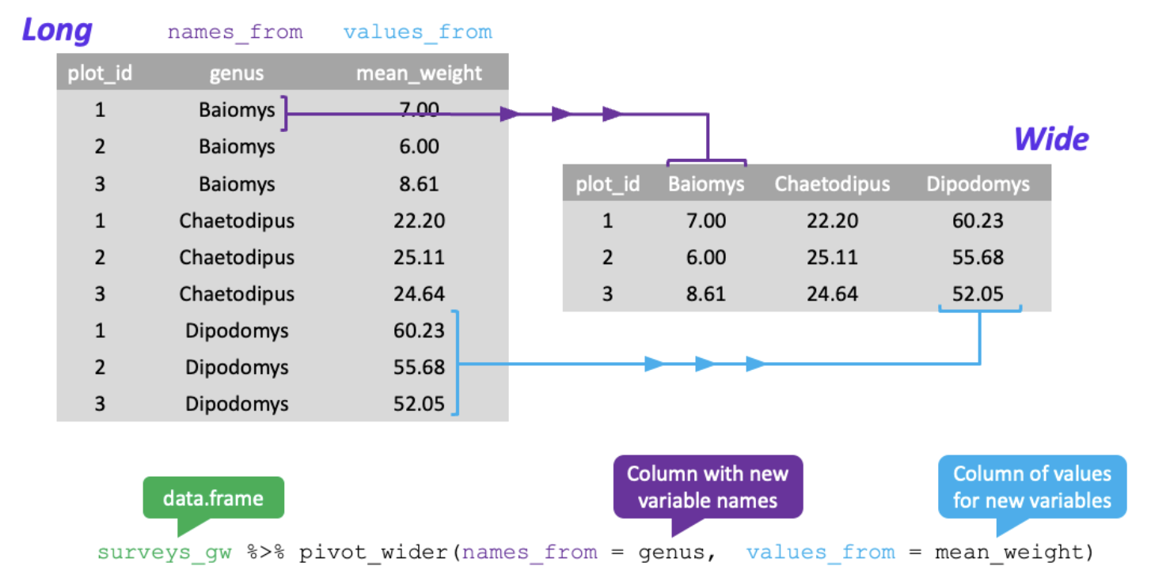
Tidyr: Pivoting from long to wide format

Slide 28
Tidyr: Pivoting from long to wide format
Firstly, filter our observations and variables of interest and create a new variable for the mean_weight
surveys_gw <- surveys %>%
filter(!is.na(weight)) %>%
group_by(plot_id, genus) %>%
summarize(mean_weight = mean(weight))
Pivoting from long to wide
surveys_wide <- surveys_gw %>%
pivot_wider(names_from = genus, values_from = mean_weight)

Slide 29
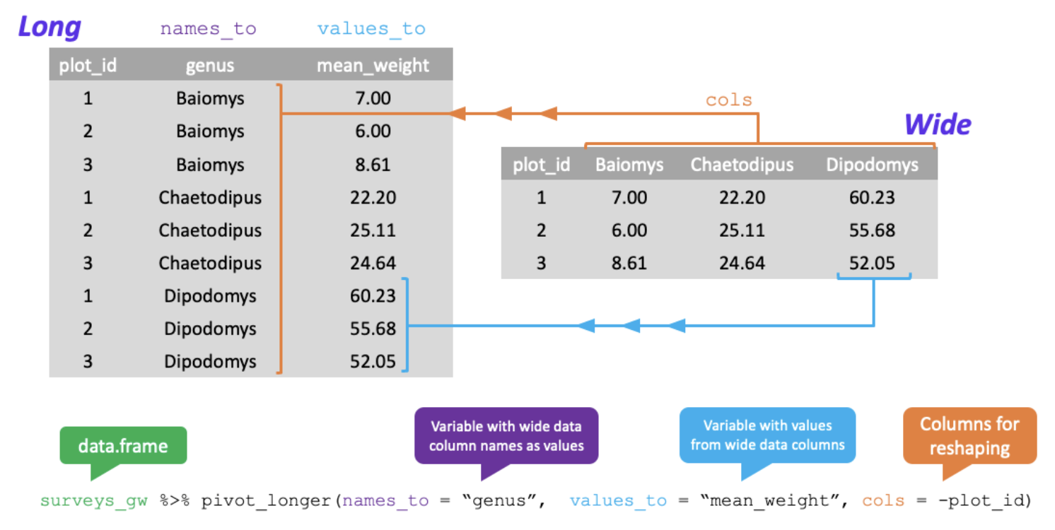
Tidyr: Pivoting from wide to long format

Slide 30
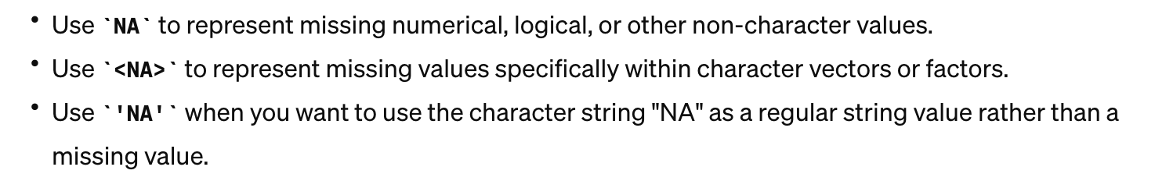
Dplyr: Group_by and summarize NaN?? NA? What the heck.

